Slide 1

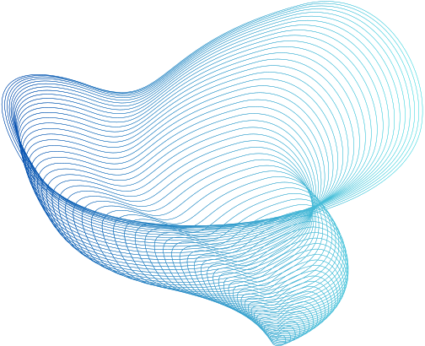
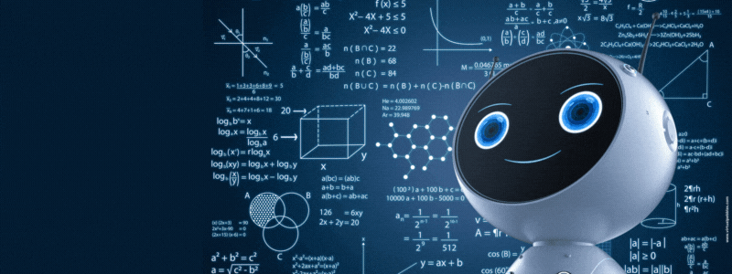

SSL APPROACH COMPARISON

Slide 2
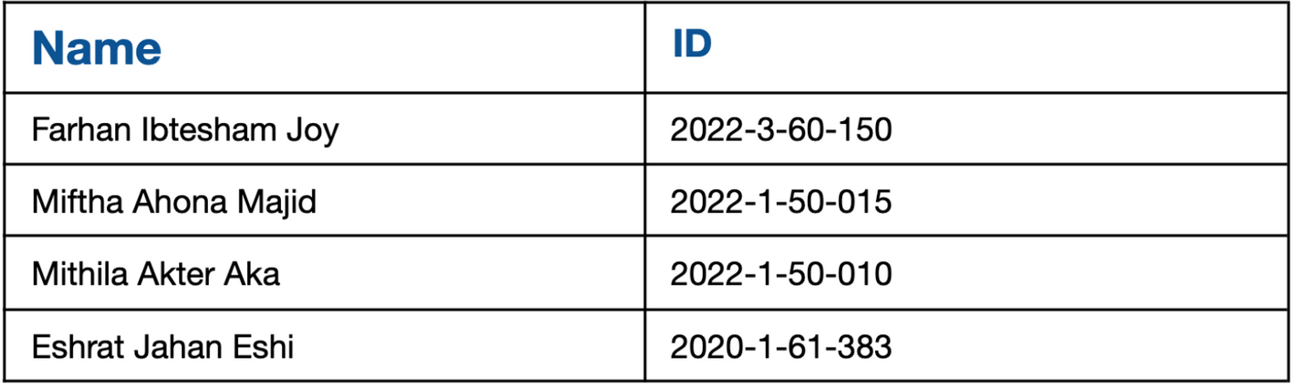
GROUP MEMBERS

Slide 3
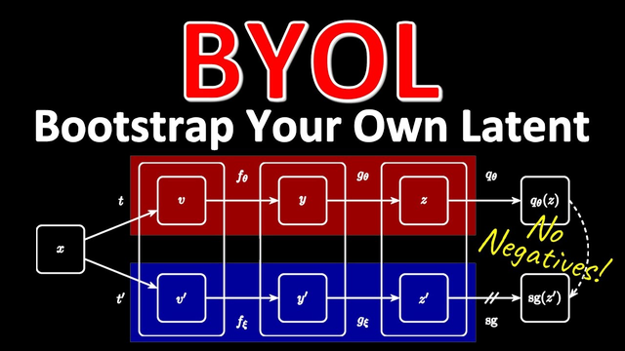
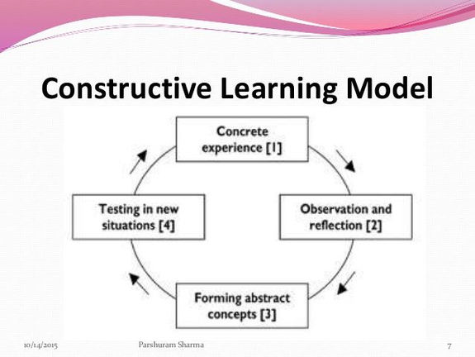
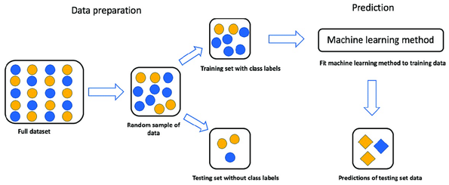
BYOL (BRING YOUR OWN LICENSE)
BYOL stands for “Bootstrap Your Own Latent,” a self-supervised learning method.
It learns image representations without using labels.
BYOL uses two neural networks: an online network and a target network.
It avoids negative pairs, unlike contrastive learning methods.
BYOL achieves strong performance using only positive sample predictions.

Slide 4

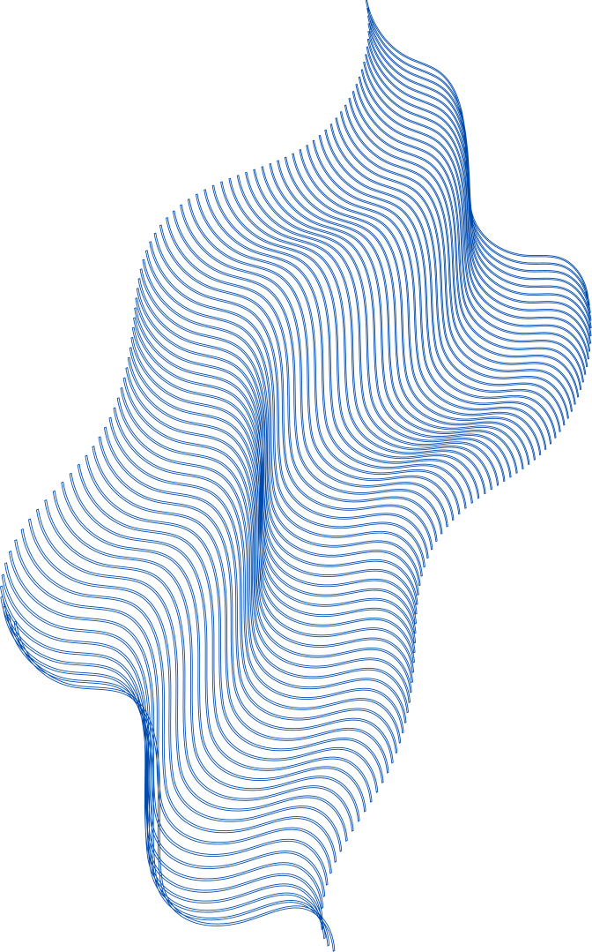
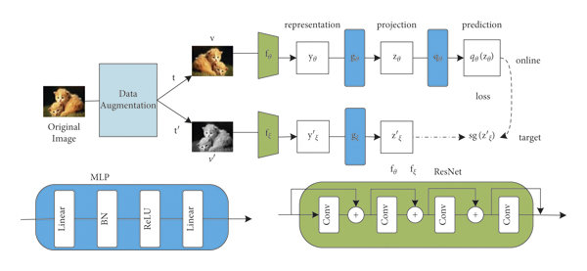
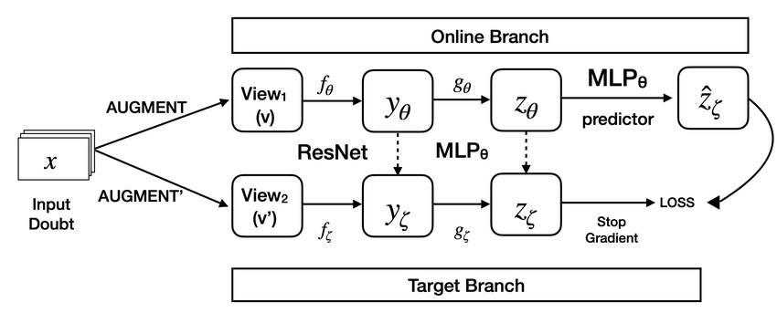
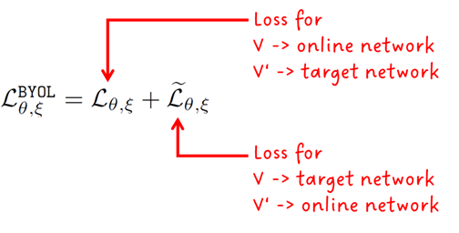
BYOL Architecture
BYOL: Self-supervised learning without labels or negative pairs
Uses Online and Target networks (same architecture)
Target network updated slowly via EMA
Two random augmentations of same image → View₁ & View₂
Online branch has extra predictor MLP
Loss: Predict target projection from online view (L2 after normalization)
Symmetrized loss + stop-gradient on target branch
Trains only online network; target follows slowly

Slide 5


WHY BYOL?
Severe class imbalance & scarce labels → BYOL needs zero labels
Brain MRIs vary in intensity but share anatomy → BYOL builds augmentation-invariant robust features
Rare AD cases → BYOL skips negative sampling bias that harms contrastive methods
Predictor + target asymmetry stops collapse → stable training on similar normal (CN) scans
Multiple studies show BYOL outperforms on MRI/CT → best downstream accuracy with

Slide 6
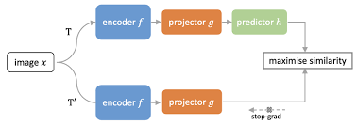
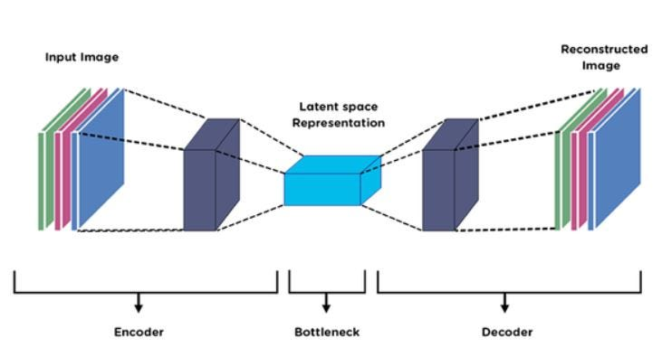
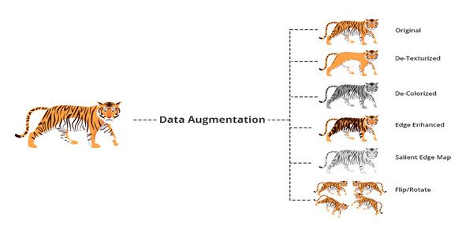
SIMSIAM(SIMPLE SIAMESE)
SimSiam: Simple Siamese self-supervised learning
No negative pairs, no momentum encoder
Twin networks with shared weights + stop-gradient
Predictor MLP in one branch prevents collapse
Minimizes cosine distance between two augmented views

Slide 7
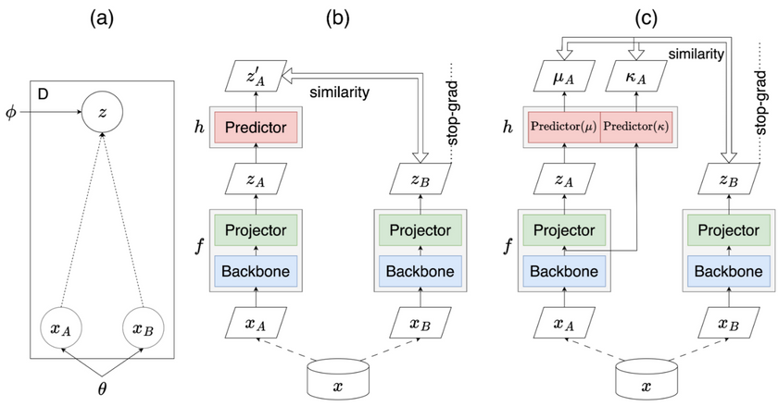
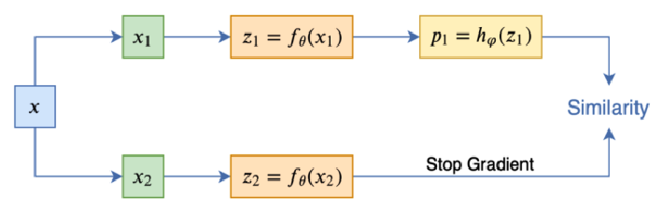
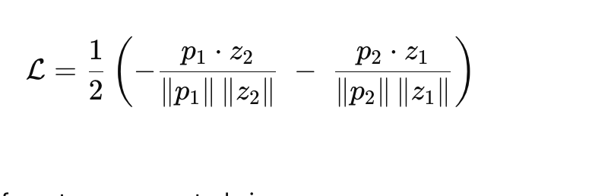
SIMSIAM ARCHITECTURE
SimSiam: Self-supervised, no negatives, no momentum
Two identical networks with shared weights
One branch uses stop-gradient, other has predictor MLP
Applies two random augmentations to same image
Predicts output of one view from the other
Loss: negative cosine similarity (normalized + stop-grad)
Predictor + stop-gradient prevents collapsing
Extremely simple yet highly effective pretraining

Slide 8

WHY SIMSIAM?
Zero labels needed → perfect for scarce annotated medical MRI data
No negative pairs → avoids sampling bias in highly imbalanced AD/CN datasets
Extremely simple & lightweight → faster training, lower memory on 3D brain scans
Stop-gradient + predictor effectively prevents collapse → stable on similar normal (CN) MRIs
Matches or beats BYOL/SimCLR on medical imaging tasks with far less complexity

Slide 9
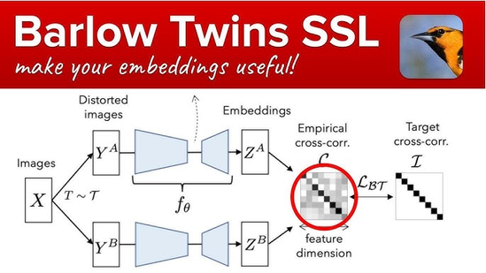
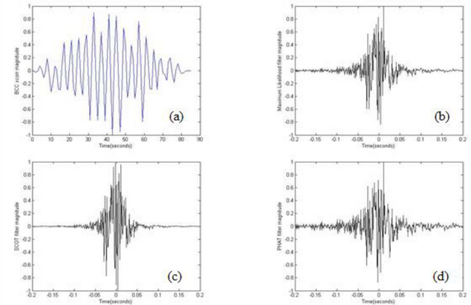
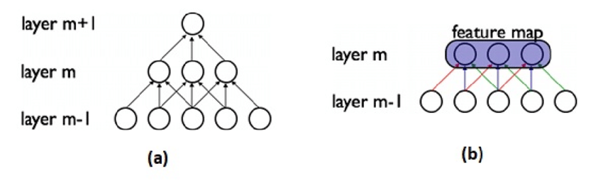
BARLOW TWINS
Barlow Twins: Self-supervised, no negative pairs
Redundancy reduction via cross-correlation matrix
Two augmented views → Siamese network (shared weights)
Loss: Make correlation matrix close to identity
Simple, collapse-free, momentum-free method

Slide 10
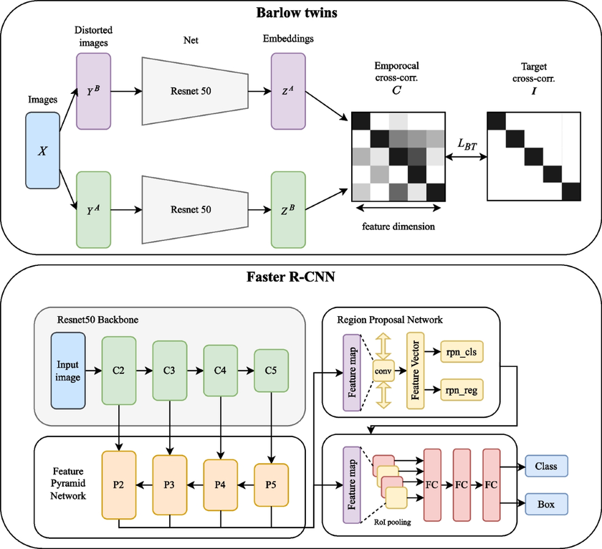
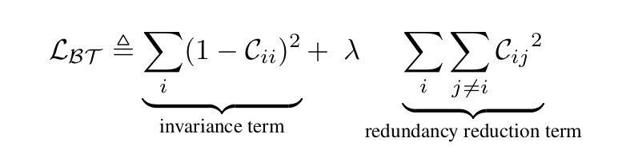
BARLOW TWINS ARCHITECTURE
Barlow Twins: Self-supervised via redundancy reduction
Two random augmentations of same image → twin branches
Identical network with shared weights
Outputs → cross-correlation matrix C (normalized)
Loss = ∑(C_ii - 1)² + λ∑_{i≠j} C_ij²
Forces on-diagonal=1, off-diagonal≈0 → decorrelated features
No momentum, no negatives, no stop-gradient
Highly robust & simple pretraining method

Slide 11

WHY BARLOW TWINS?
No labels required → ideal for limited annotated brain MRI data
No negative pairs → eliminates sampling bias in highly imbalanced AD/CN classes
Redundancy reduction → learns decorrelated features robust to MRI intensity/contrast shifts
Zero momentum & no predictor → simpler, faster, more stable training than BYOL/SimSiam
Proven stronger on medical imaging (MRI/CT) → higher linear probing & few-shot accuracy

Slide 12


